Slide 1
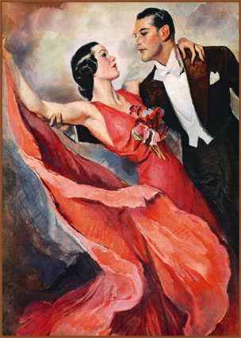
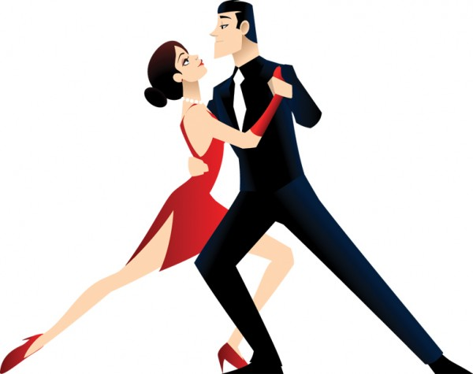
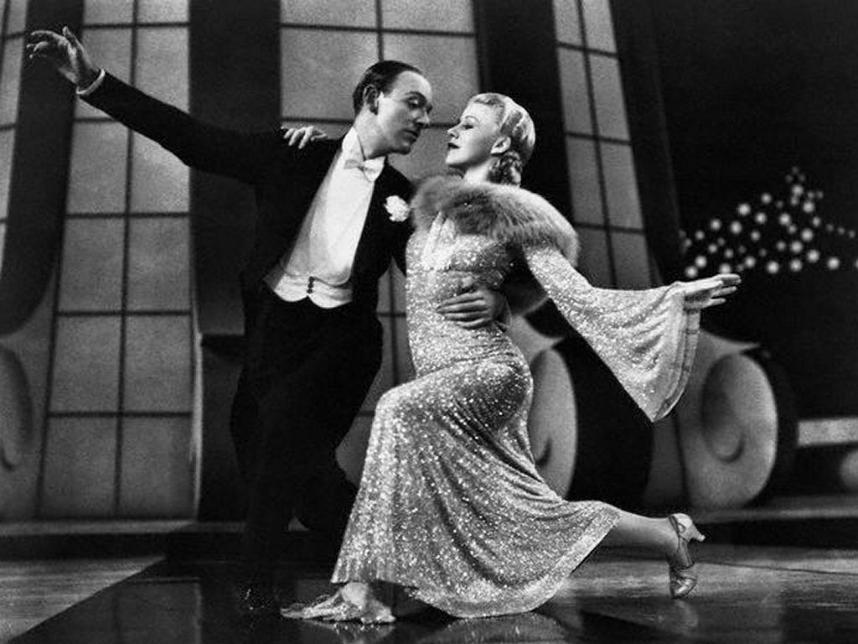
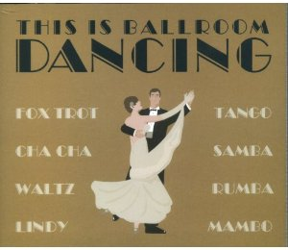
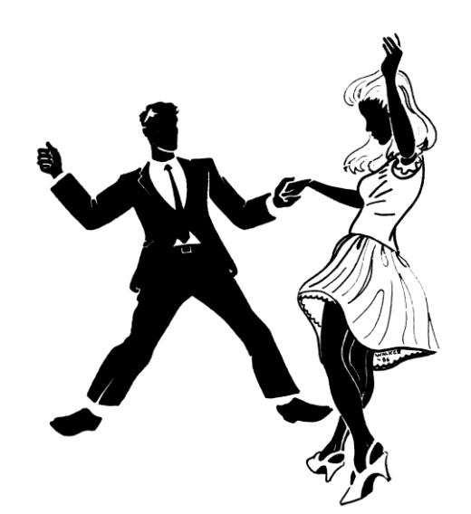
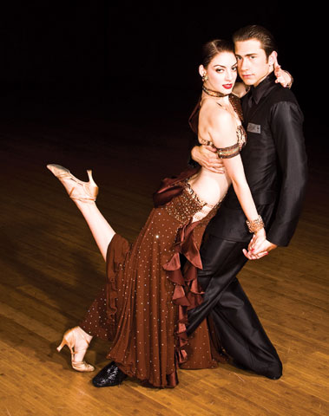
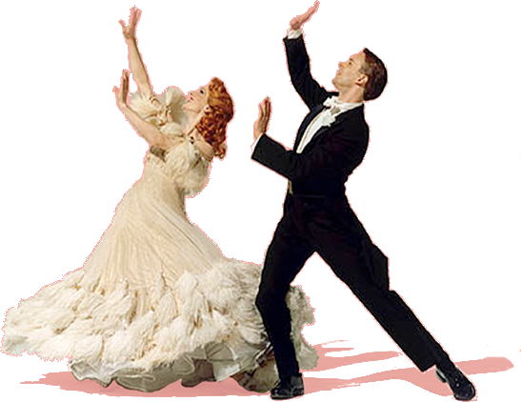

Slide 2
Ballroom Dance Styles American vs. International
The International Style
More competitive style of ballroom dancing.
More formal, difficult, strict guidlines
Shares many of the same dances with the American Style
American Style ballroom
Easier for students to learn
Not as strict
More conducive to social dancing.

Slide 3
Ballroom Dance Styles Smooth vs Latin
American Smooth aka International Standard:
Move in the LINE of DANCE (Counter-clockwise)
Elegant, beautiful, and dramatic
American Rhythm aka International Latin:
Sensual and romantic Latin dances as well as the American East Coast Swing.
“Spot” dances

Slide 4
Ballroom Dance Styles
Smooth/Standard Dances
*Waltz
*Foxtrot
*Tango
Quickstep
Vienese Waltz
Rhythm/Latin Dances
*Cha Cha
*Rumba
*Swing
Paso Doble
Samba
Bolero
Salsa- Club/Social
Merengue-Club Social

Slide 5
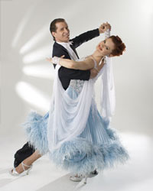
Waltz
Origin: Germany
Music- Instrumental, Slow Balads
Meter: 3/4
Tempo: 84 - 96 BPM
Rhythm: 123 123
Quick quick quick

Slide 6
Waltz- cont’
Characteristic Styling:
Smooth progressive dance
Graceful, Elegant
Rise & fall and Sway
Heel leads
“Smooth” frame

Slide 7
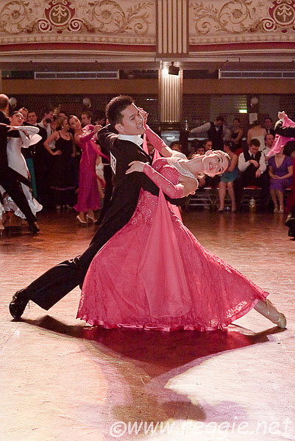
Waltz
Basic Steps
Box
Rotating Box
Hesitation
Underarm Turn
Fifth Position Breaks
Progressive

Slide 8
Waltz- History
The name ‘Waltz’ comes from an old German word walzen, meaning to roll, turn, or glide.
It evolved from a German and Austrian peasant dance of the 17th and 18th century called the Laendler and the Allemande in ¾ time replacing the heavy hopping and jumping movements with more polished and graceful gliding.
Waltz was the first dance in which the man and lady danced with body contact, and was considered quite scandalous in its day.
It was immensely popular all across Europe, first with the lower classes and then with the aristocracy.
The fast Viennese waltz vs the slower “Boston”

Slide 9
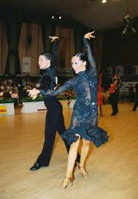
Cha Cha
Origin: Cuba
Music: Medium-tempo Latin music
Meter:4/4
Tempo:112 - 120 BPM
Rhythm: 2, 3, 4&1, 2, 3, 4&1
Slow, slow, slow, quick, slow
Characteristic Styling:
Rhythm or Latin Dance
Toe leads, Cuban motion
Staccato in nature
Fun, flirty, flashy and sensual
Consists of triple chasse steps (cha cha cha) and rock steps

Slide 10
Cha Cha
Basic Steps
Side Basic
Progressive Basic (travels front & back)
Crossover
Pivot Turn
Underarm turn
Locks

Slide 11
Cha Cha- History
Music of the Cha Cha came from Cuba. It evolved from mambo, which was very fast and difficult to dance to. Cha Cha is a slowed down version of mambo, a “polite mambo,” or a “triple mambo”
The Cha Cha dance is a North American innovation born from Latin migration to North America (particularly New York) and an inter-mixing of musical styles from many parts of the world (especially jazz).
Introduced to the U.S in 1954

Slide 12
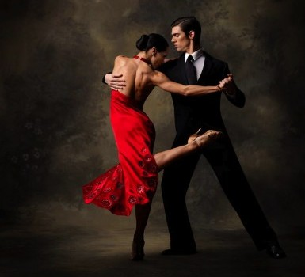
Tango- Description
Origin: Argentina
Music: Medium Tempo Orchestral,
Almost march-like
Meter: 4/4
Tempo:120-128 BPM
Rhythm:
Slow, slow, slow, quick, slow
Characteristic Styling
Smooth
Dramatic; Stalking or sneaking;
Slow and slithery
Could also be sharp and staccato

Slide 13
Tango
Basic Steps
Basic
Promenade
Rocks
Corte
Side by Side Release
Ochoes

Slide 14
Tango- History
Originated in Argentina in the mid 19th century and was derived from the Argentine milonga and candombe
Tango is often times referred to as the music of the immigrants to Argentina.

Slide 15
Rumba
Origin:
Music: Medium Tempo Latin Music
Meter: 4/4
Tempo:128-144 BPM
Rhythm:
Slow quick quick, slow quick quick
Characteristic Styling:
Rhythm or Latin
Slow and sensual with hip movements
Cuban motion toe leads

Slide 16
Rumba
Basic Steps
Basic Box
Rotating Box
Crossover Breaks (Front)
Cross Over Breaks (Back)
Side Breaks
Pivot Turns
Underarm Turn
Fifths
Cuban Walks

Slide 17
Rumba-History
Rumba is a composite of several dances form Cuba including the guaracha, bolero, son, guagira, danzon
All have similar rhythms that can be traced to religious and ceremonial dances of Africa

Slide 18
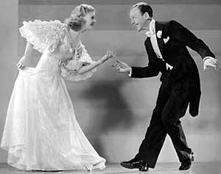
Foxtrot- Description
Origin: America
Music: Medium Tempo Jazz Swing
Music
Meter: 4/4
Tempo:120-136 beats per minute
Rhythm: Slow slow quick quick
Characteristic Styling:
Smooth, progressive dance
Heel leads
Long, continuous flowing movements
Simple combination of walks and chasses ideal for social dancing

Slide 19
Foxtrot
Basic Steps
Basic
Rotating Basic
Promenade
Underarm turn
Sway
Chasse

Slide 20
Foxtrot- History
Originated in the summer of 1914 by Vaudeville actor Harry Fox.
Signature dancers include Gene Kelly and Fred Astaire

Slide 21
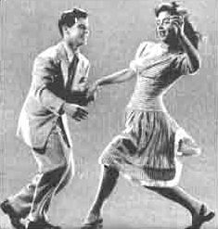
Swing- Description
Origin: America
Music: Fast Swing Music
Meter:4/4
Tempo:136-144 beats per minute
Rhythm: 1 a2, 1 a2, a2
(strong accent on 2)
Characteristic Styling:
Fun, fast
Lots of turns and flips.
Toe Leads

Slide 22
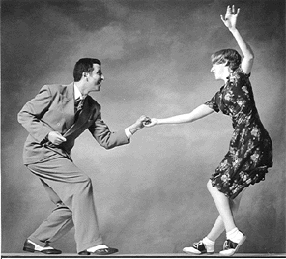
Swing- Basic Steps
Basic- single
Basic- triple
Underarm Turn- Right
(turn is on second triplet)
Underarm Turn- Left
(turn is on first triplet)
Cuddle Wrap

Slide 23
Swing History
Began in California in the 1920’s where the black community danced to contemporary jazz music and was discovered as the Charleston and Lindy Hop. The Lindy Hop was coincidentally named after President Lindbergh as both were hot press topics of the time.
The “jitterbug” variation was started in the mid 1930’s. Swing competitions began in the late 1930’s.
Formal ballroom teachers adapted the swing into East Coast Swing and West Coast Swing
Became the typical American passtime of the 50’s & 60’s.

