Slide 1
Dance 2 & Ballroom

Slide 2
What is Ballet? An artistic form of theatrical dance, in the tradition of classical technique in conjunction with music, mime and décor.

Slide 3
Principles of Ballet
French language
2 Parts- Barre & Center
Alignment- posture, neck is over shoulder girdle, shoulders over hips, hips over knees, Knees over feet
Pulling up or Lift- through the legs, stretching upward, engaging abdominals; Defying gravity

Slide 4
Principles of Ballet cont’
Turn out- outward rotation of legs and feet
Pointe- pointing of the feet- ALWAYS in classical ballet
Squareness- keeping shoulders and the hips on the same plane and parallel to each other and the floor
Weight distribution- centering over the feet. “foot triangle,” no rolling over

Slide 5
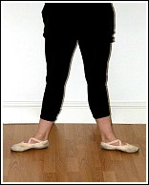
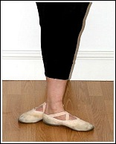
Ballet Positions
Positions of the feet
1st
2nd
3rd
4th
5th

Slide 6
Ballet Positions
Positions of the arms
1st
2nd
3rd
4th
5th

Slide 7
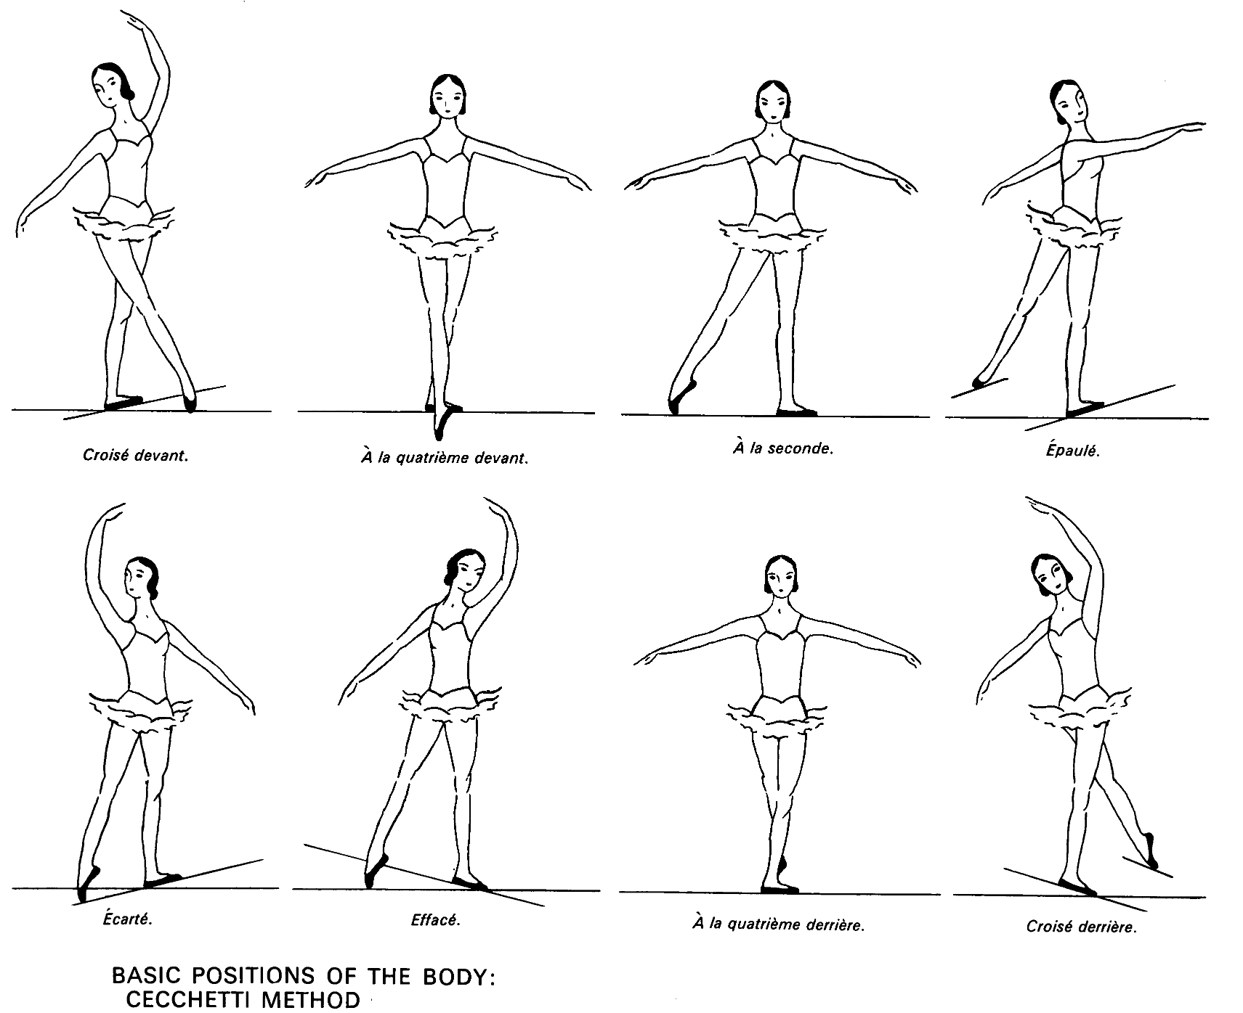
Dance 3/4 8 Positions of the Body

Slide 8
Croise devant – crossed in front (krwah-ZAY duh-VANH) A la quartieme devant – to the fourth front (ah la ka-tree-EM duh-VAHN) Ecarte – thrown wide apart, separated (ay-kar-TAY) Efface – shaded (eh -fa -SAY) A la seconde – to the second (ah la suh-GAWND) Epaule – shouldered (ay-poh- LAY) A la quatrieme derriere – to the fourth back (ah la ka-tree-EM deh-RYEHR) Croise derriere -crossed in back (krwah-ZAH deh-RYEHR)

Slide 9
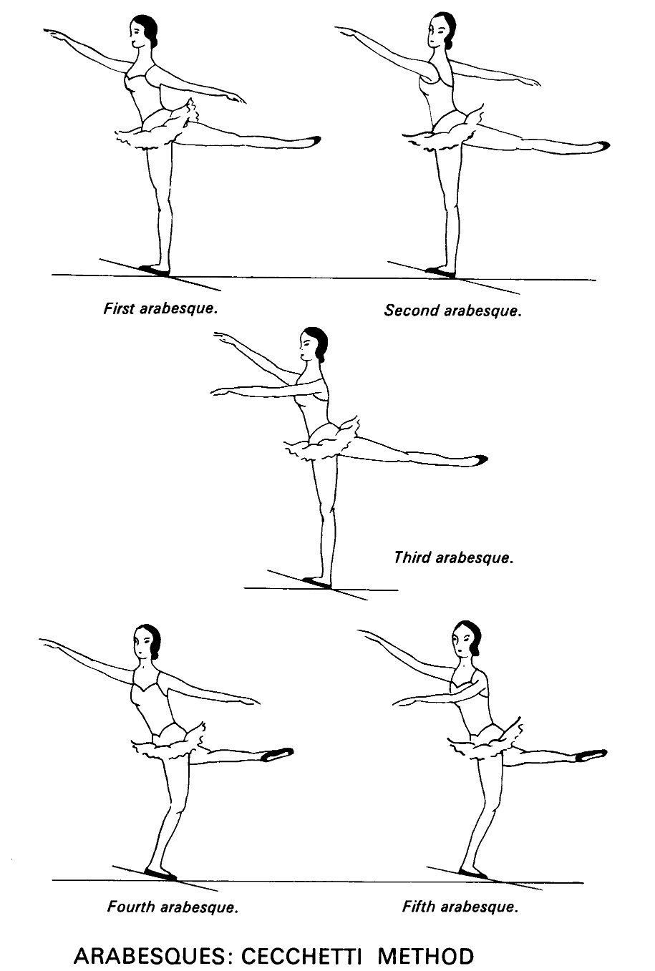
4 Arabesque Positions

